Slide 1

18CSC206J SEPM Software Engineering and project management
SEPM-Project
Online Music streaming website

Slide 2
ONLINE MUSIC STREAMING WEBSITE STREAM ANY WHERE
PLAYDIOUS

Slide 3
WELCOME
Hello Everyone
We named our Project as ("Playdious")
This is an online music streaming website with
this app we can stream music whenever and wherever

Slide 4

Our team
Team members of Playdious
Aakash Raj (RA2011031010128) Team leader & Developer
My role is to Getting the report of project Analysis and Develop the code for the project
MEDHA (RA2011031010105)
My role is to designing the UI/UX of the app and developing the front end of the app
BALADITYA(RA2011031010126)
I suggest the improvements in the projects and receiving the feedback from the users and defining the Functional Architecture of the project

Slide 5
About our project
This project is created to provide a user friendly online music & podcast streaming
from different languages in one place .It is an interactive, intuitive and dynamic online music & podcast player.
As a result our website is completely free of cost. This website is a collection of songs from different languages and this can play podcasts from different studios and radio stations.

Slide 6
Approach Technologies used : Browser : google chrome which is most popular browser by google
➢Languages: HTML, CSS, Java script ➢ Protocols : HTTP - The protocol requests the website from Google’s server and then receives a response with the HTML, CSS, and JavaScript of the website. Back end tech we used Node JS Data bases & SQL
➢ Git : GitHub
➢ Access to online music ➢ Larger Storage

Slide 7
Limitations :
List what could prevent the success of the project
➢ Less categories in project
➢ Not all genres and songs available but still we can provide you the best .
➢ Lack of coding language knowledge in the back end field.

Slide 8
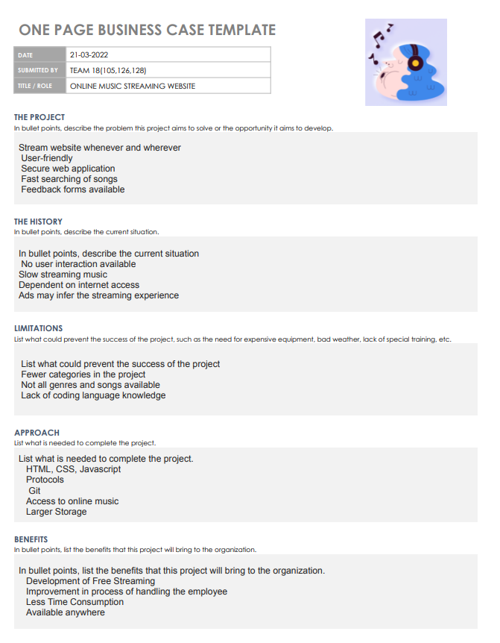
Business case Template

Slide 9
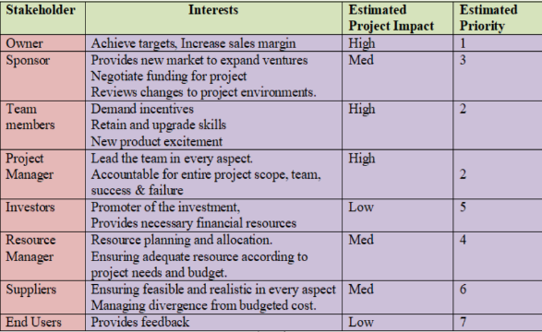
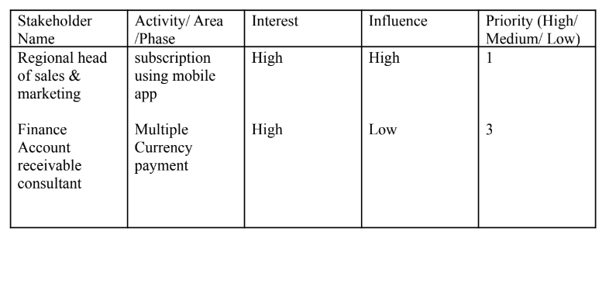
Methodology- *Waterflow design of software designing is being used *It is done – Gathering necessary components and then combining them to form a complete software

Slide 10
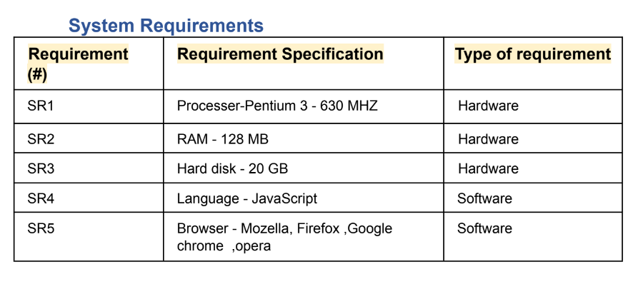
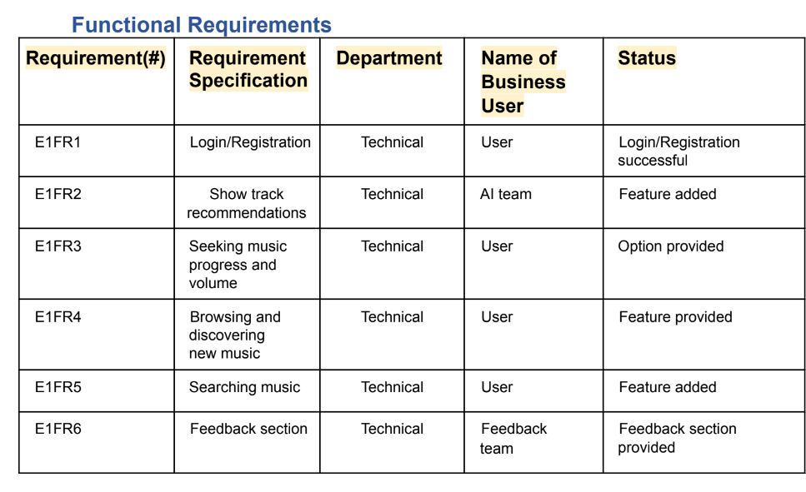
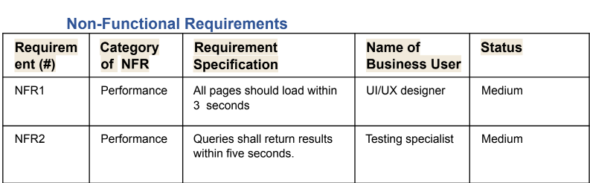
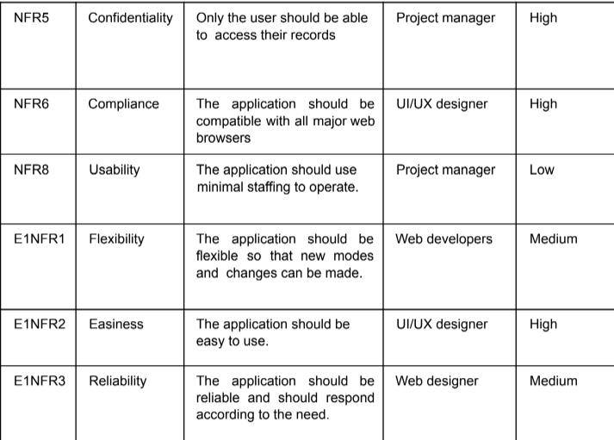
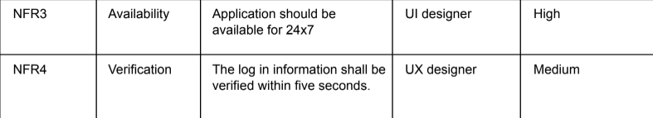

Slide 11
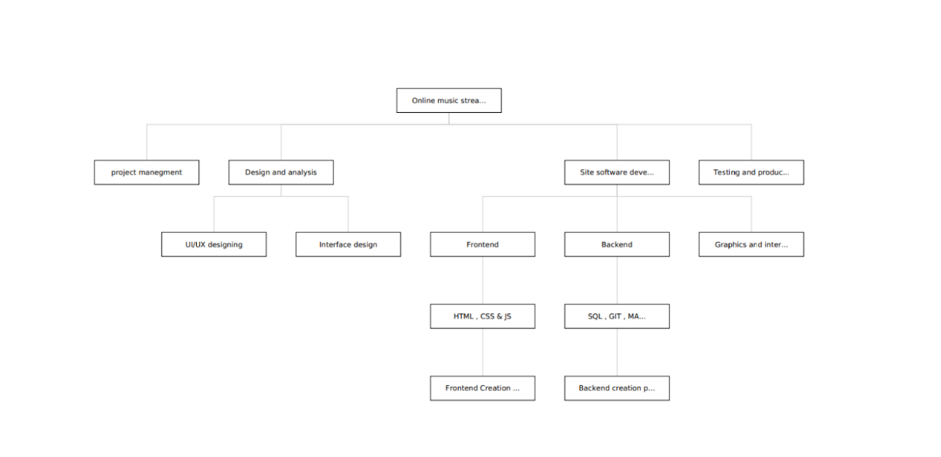
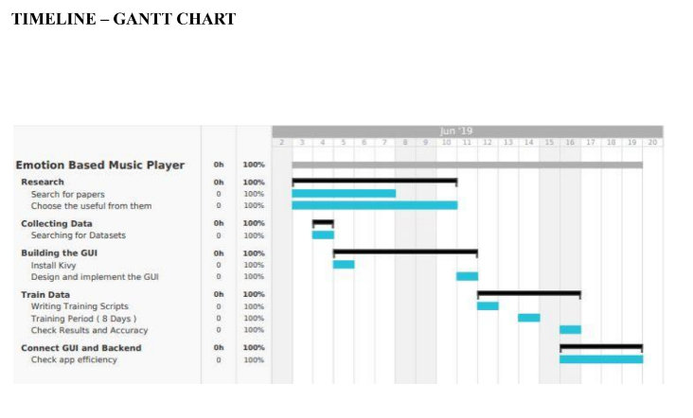
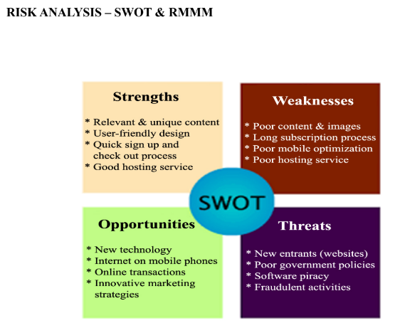
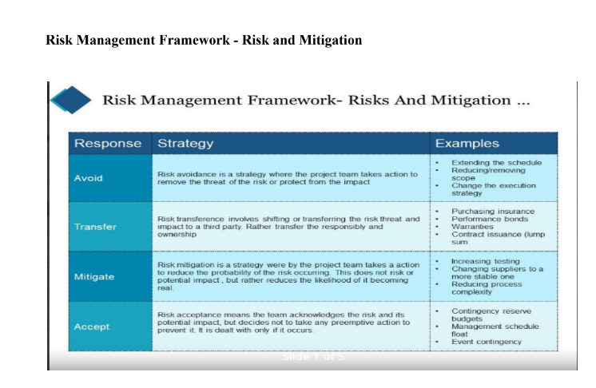

Slide 12
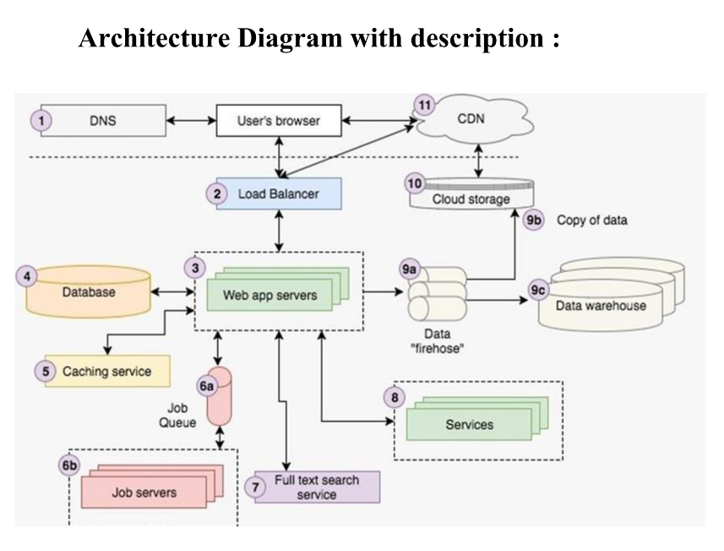
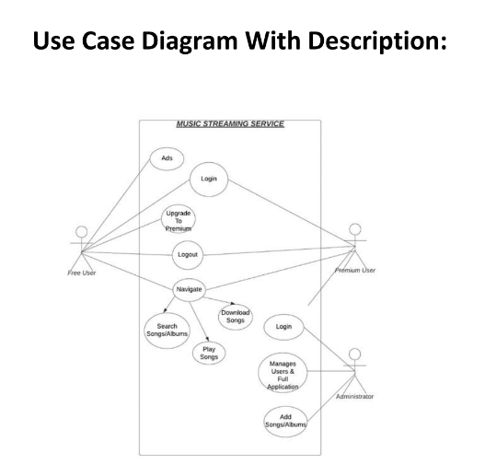
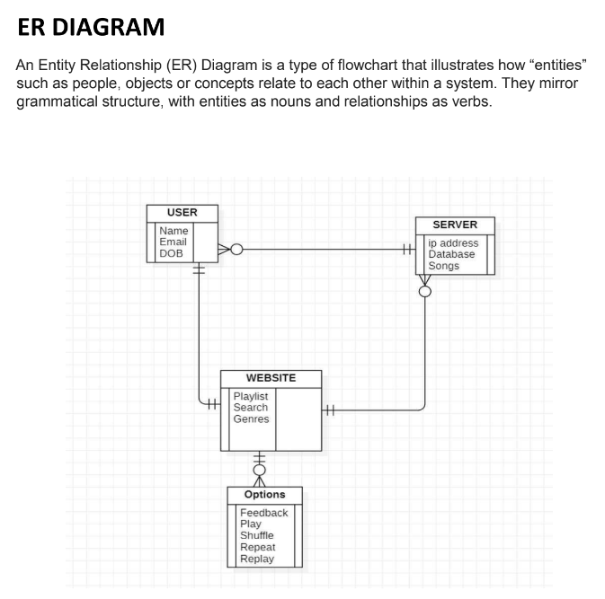
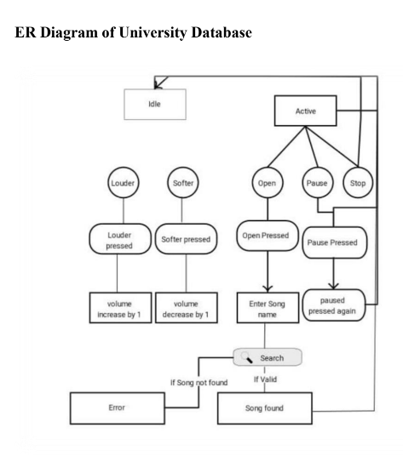

Slide 13

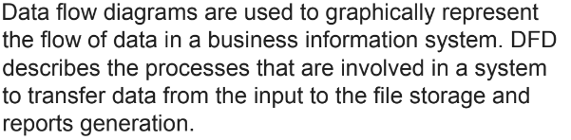
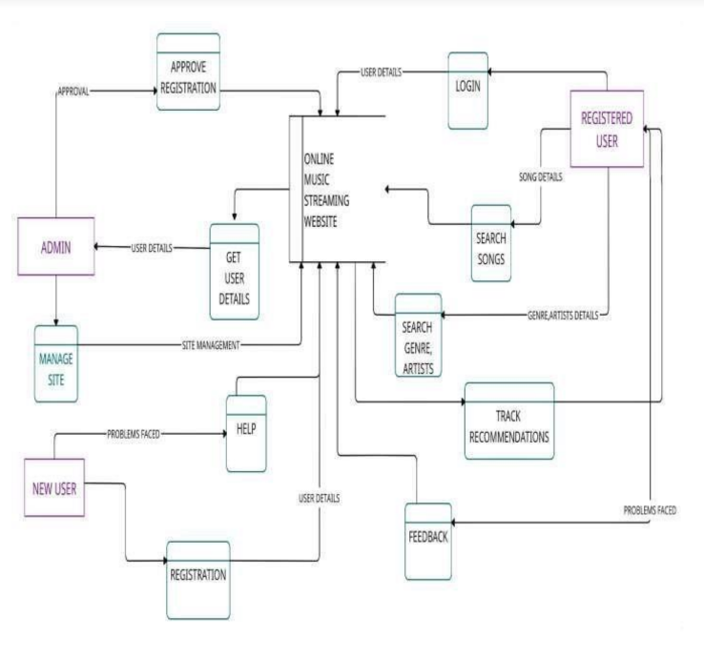

Slide 14
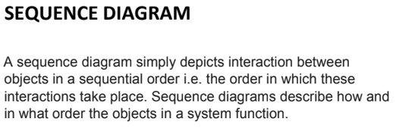
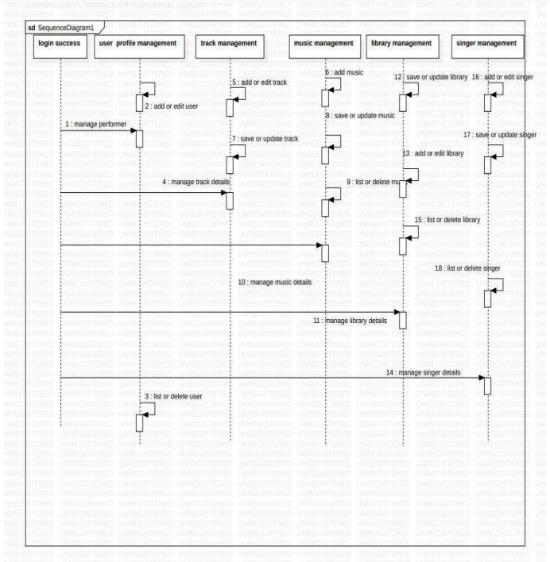
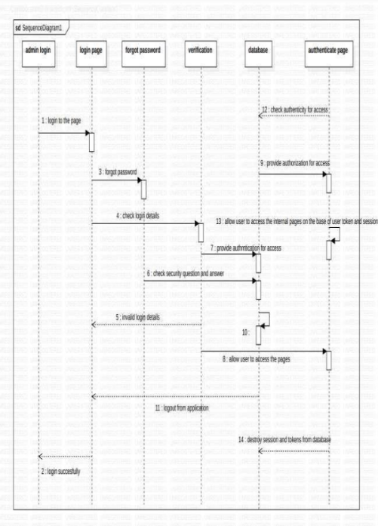
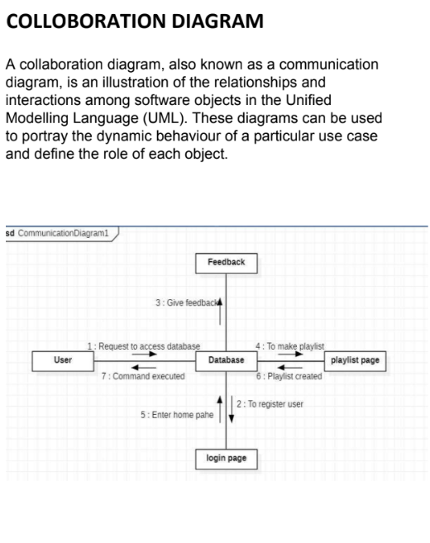

Slide 15
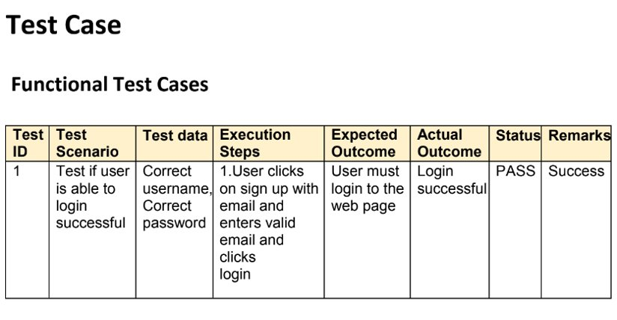
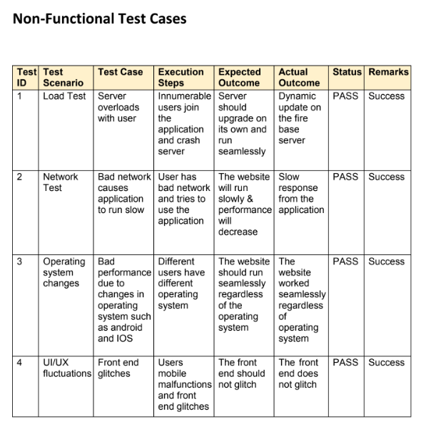
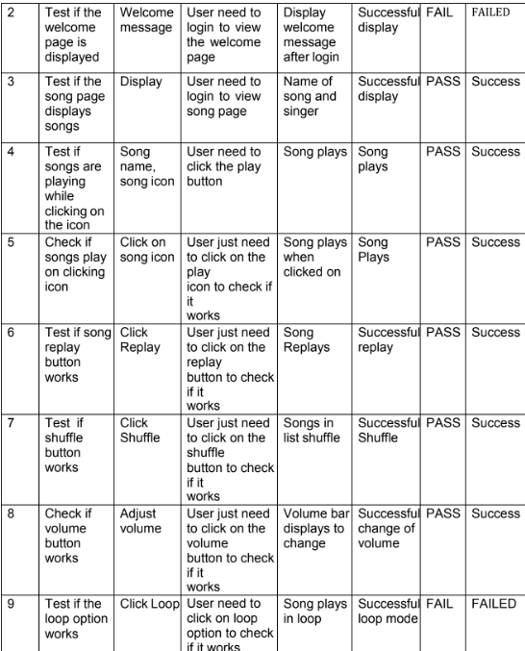

Slide 16
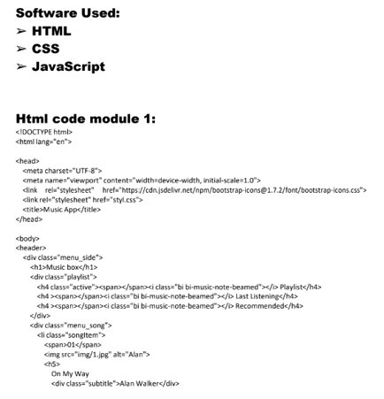
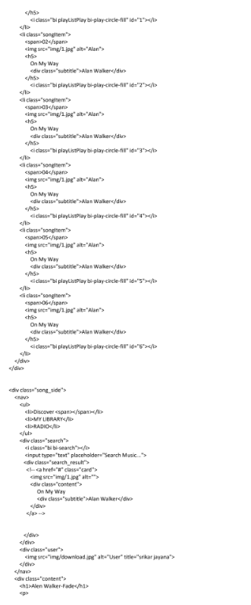
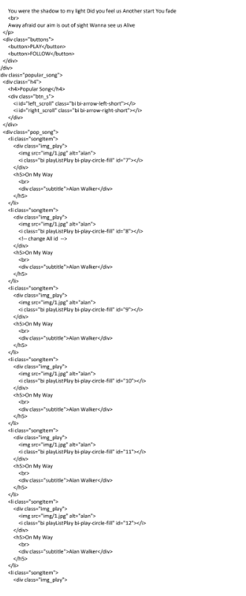
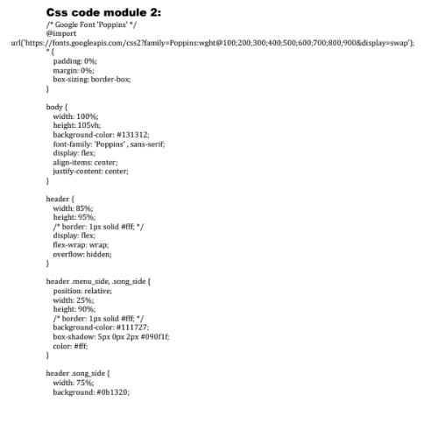
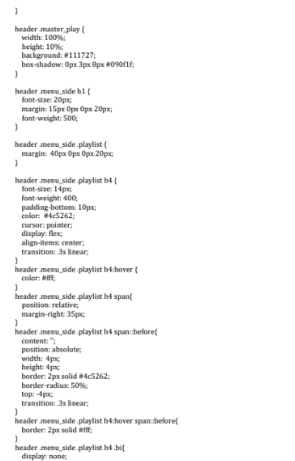
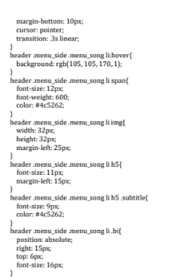

Slide 17
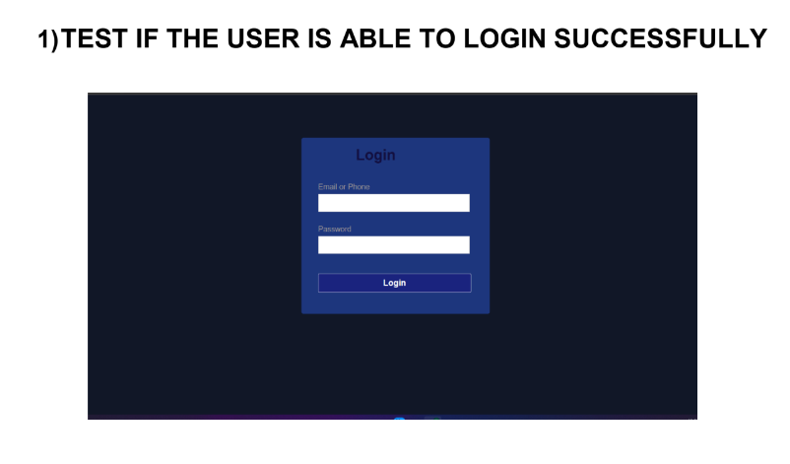
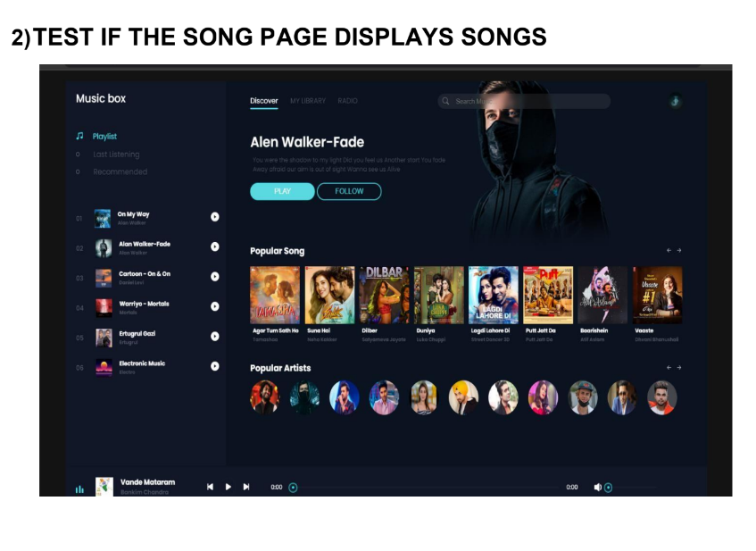
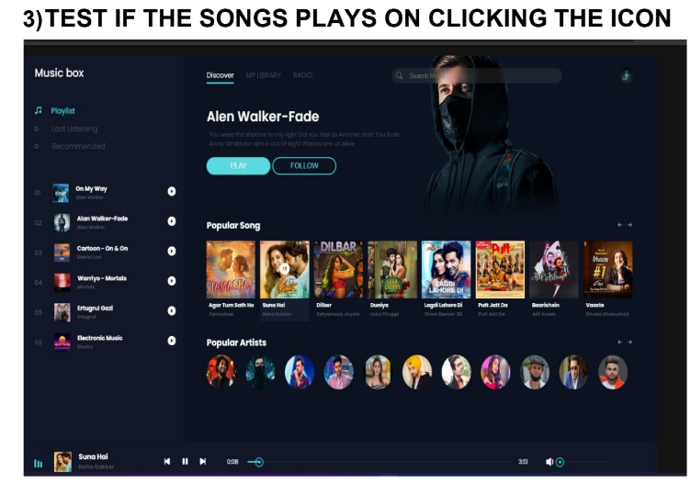
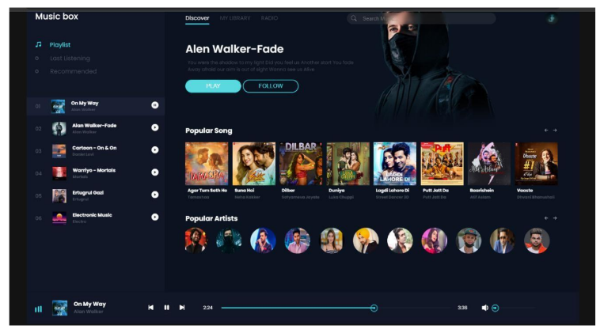

Slide 18
Wed page ref link : easyans.github.io/playdiousdilkatune/
Acknowledgement-
Figma (UI/UX)
Dribble
Google
Vs code
HTML,CSS & JS
GIT
GIT HUB

